Slide 1
IMPLEMENTATION AND COMPARISON OF MPPT CONTROLLERS
Project presentation by
SAYANTIKA PAUL
170906082
SUYASH BHATT
170906140
Under the guidance of
Prof Dr. R. Shivarudraswamy
Dept. of Electrical and Electronics
MIT Manipal
Department of Electrical & Electronics Engineering
1

Slide 2
PRESENTATION OUTLINE
1. Introduction
2. Literature Review
3. Objectives
a. Individual objectives( in case of group projects)
4. Methodology of the Work
5. Results & Analysis
6. Conclusion
7. Impact on Environment/Society/Individual/Commerce/ or Other factors
8. References

Slide 3
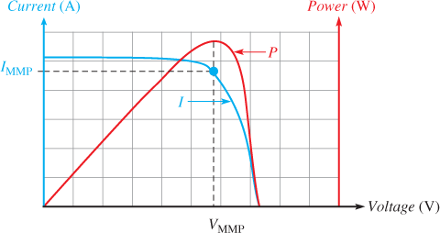
INTRODUCTION
Conventional sources of energy will not persist forever; it is essential to look for alternative sources of energy.
Harnessing solar energy is one of the alternatives which has been widely implemented since the source of solar energy is highly ubiquitous.
In PV modules, the power output depends on the input conditions which are solar irradiance and environmental temperature.
If the input of a system is inconsistent, naturally the output is inconsistent. For better efficiency in terms of power and cost, we need to find a solution, which is the maximum power point.
When it comes to PV modules there is a point on the characteristic curve of current vs voltage and power vs voltage where this point is available.
Fig 1. Maximum Power Point in current vs voltage and power vs voltage [11]
29-May-21
Department of Electrical & Electronics Engineering
3

Slide 4
LITERATURE REVIEW
N.Pandiarajan and Ranganathan Muth, this paper gave us insight as to how the implementation and simulation of the PV modules take place briefly in a step by step approach in MATLAB/Simulink.
Alpesh P.Parekh, Chirag T .Patel and Bhavarty N. Vaidya through this paper we could understand the detailed circuit designing part of the photovoltaic model, and gave us easy understanding on how to design our own model.
Pandiarajan N, Ramapraphu R, and Ranganath Muthu, this paper gave us another perspective to the design of the PV model, which helped in better development of our model design. We gathered insights from the MATLAB/Simulink model and designed our own model.
A. Dolara, R. Franda, S. Leva, this paper has given insights to different algorithms that can be implemented. It gave us a better understanding of the algorithms that can be implemented.
Anuradha, S. Kumar, Incremental Conductance algorithm has been explained here briefly, this has helped us to get in-depth understanding of the concept.
29-May-21
Department of Electrical & Electronics Engineering
4

Slide 5
OBJECTIVES
Main Objective
The objective of this project is implement and compare two algorithms to get maximum power output with the help of MPPT controller and to find the best amidst the two.
Individual Objective
Objective of Student 1(Sayantika)
Our objective of this project is to implement the algorithms to establish the maximum power output of PV module using MPPT controllers.
Objective of Student 2(Suyash)
Our objective of this project is to run simulation using MATLAB and to improve the efficiency of the PV system.
29-May-21
Department of Electrical & Electronics Engineering
5

Slide 6
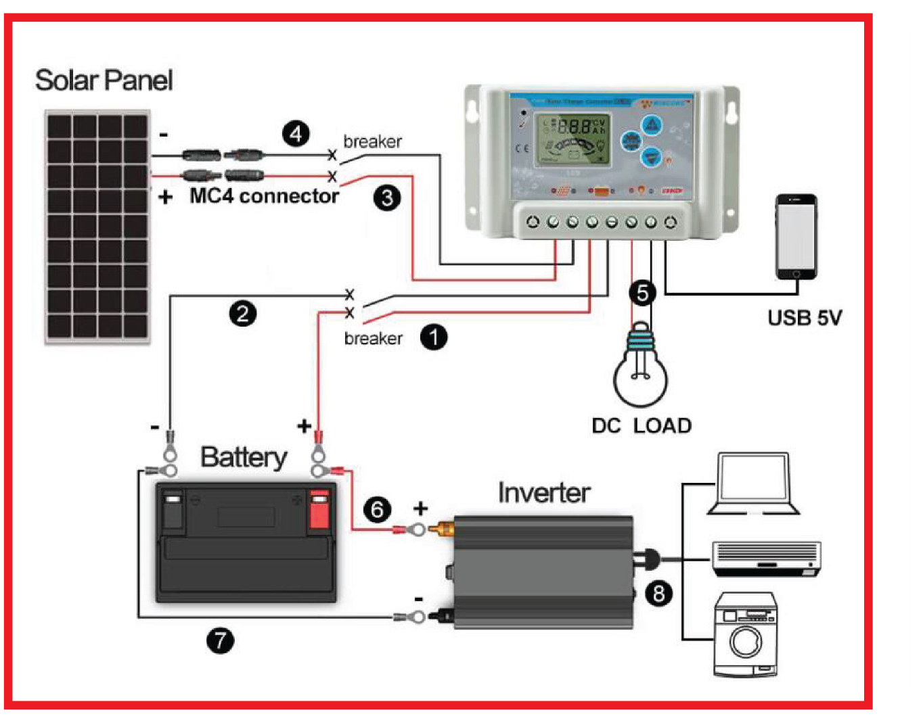
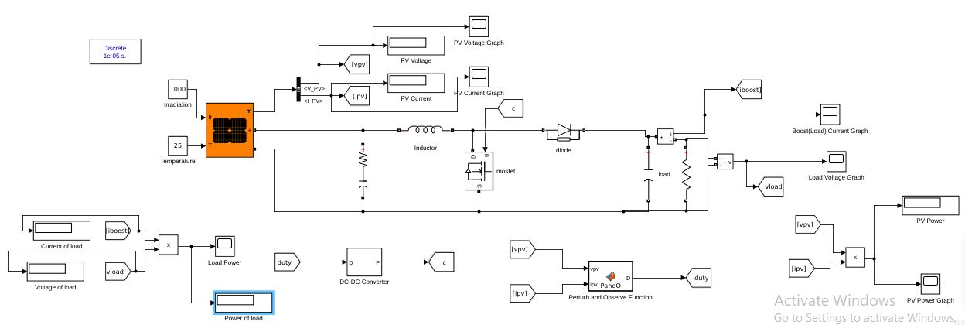
METHODOLOGY OF THE WORK
Fig 2. Designed Model
Fig 3. Practical Model [15]
29-May-21
Department of Electrical & Electronics Engineering
6

Slide 7
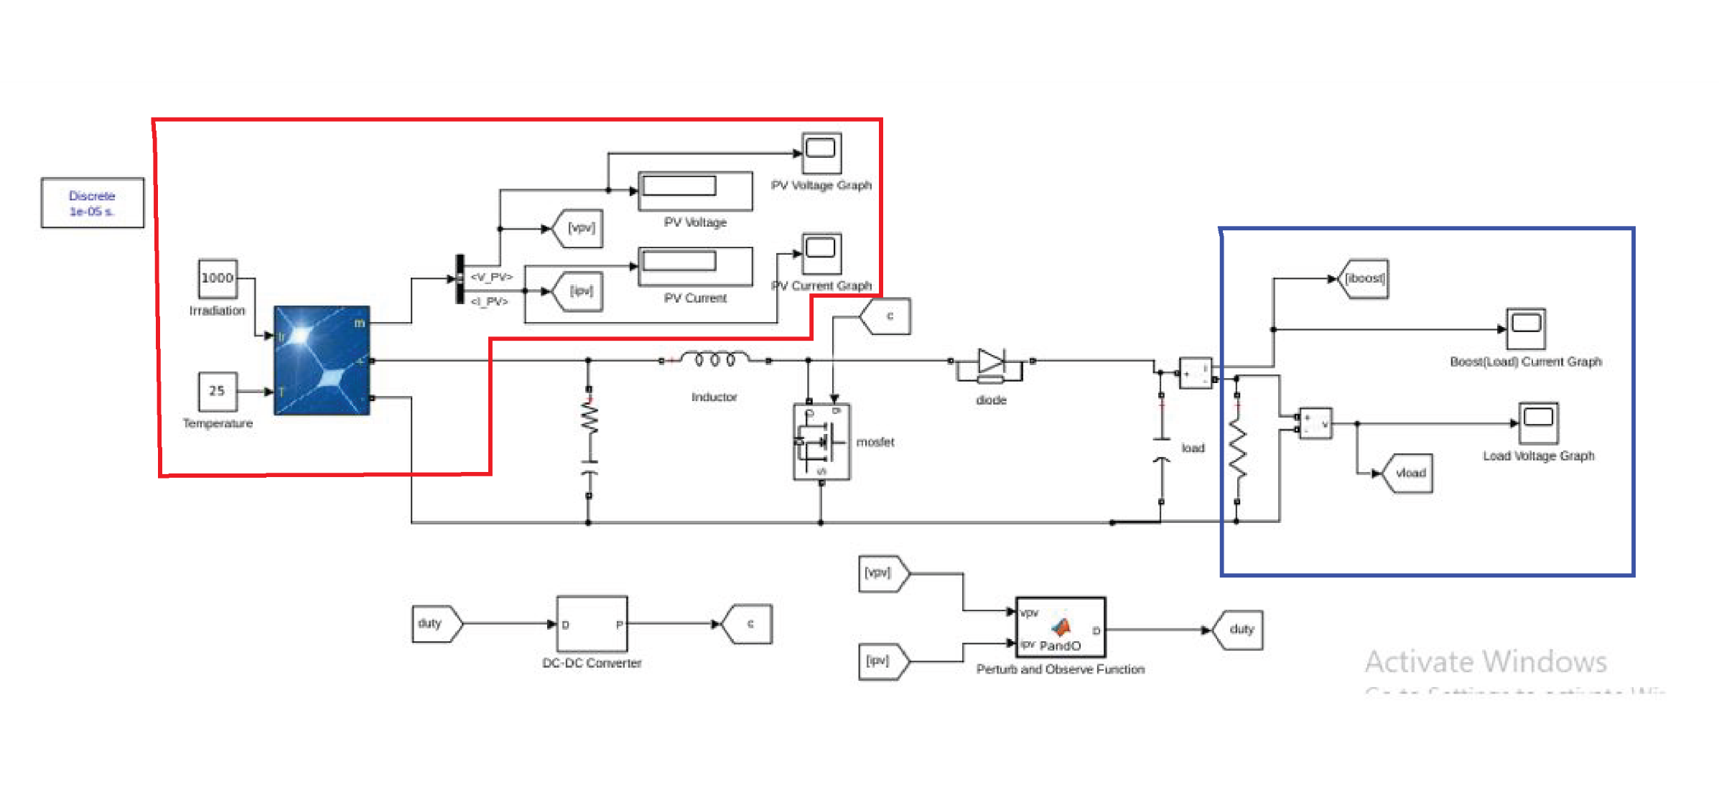
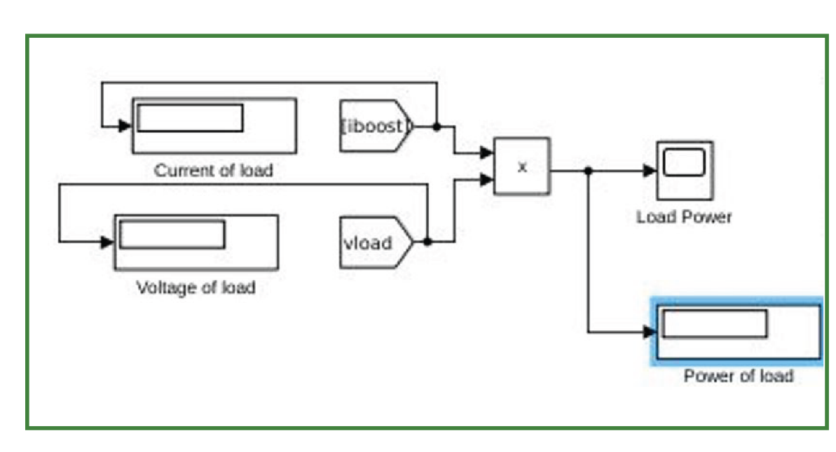
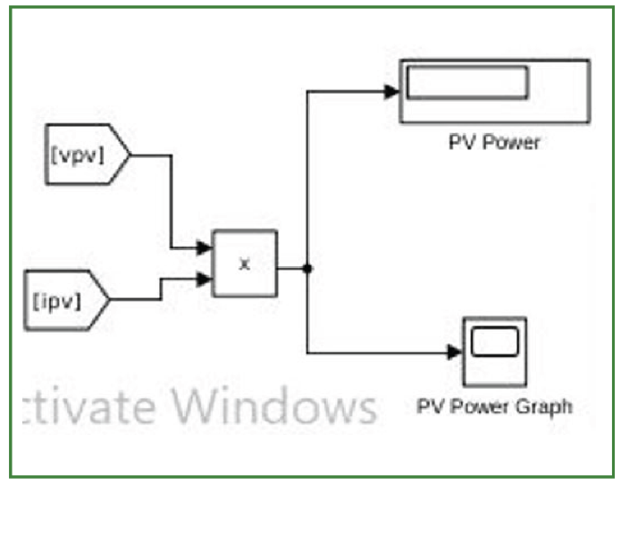
Fig 4. Model Design(detailed)

Slide 8
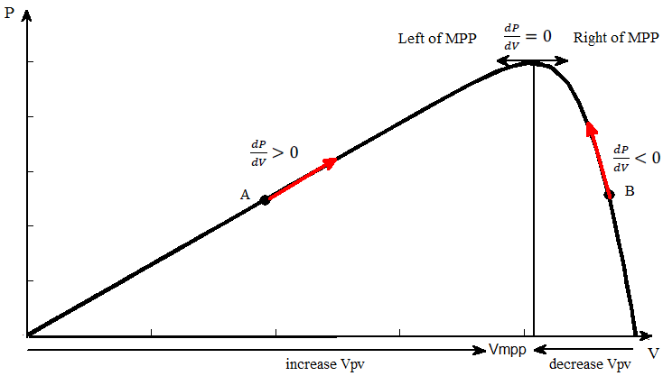
PERTURB AND OBSERVE ALGORITHM
Fig 5. Perturb and Observe graph [13]

Slide 9
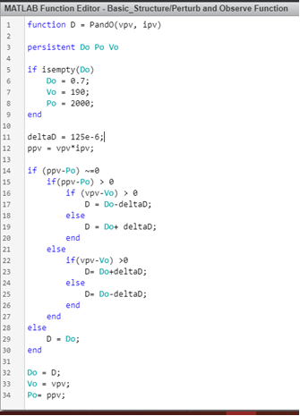
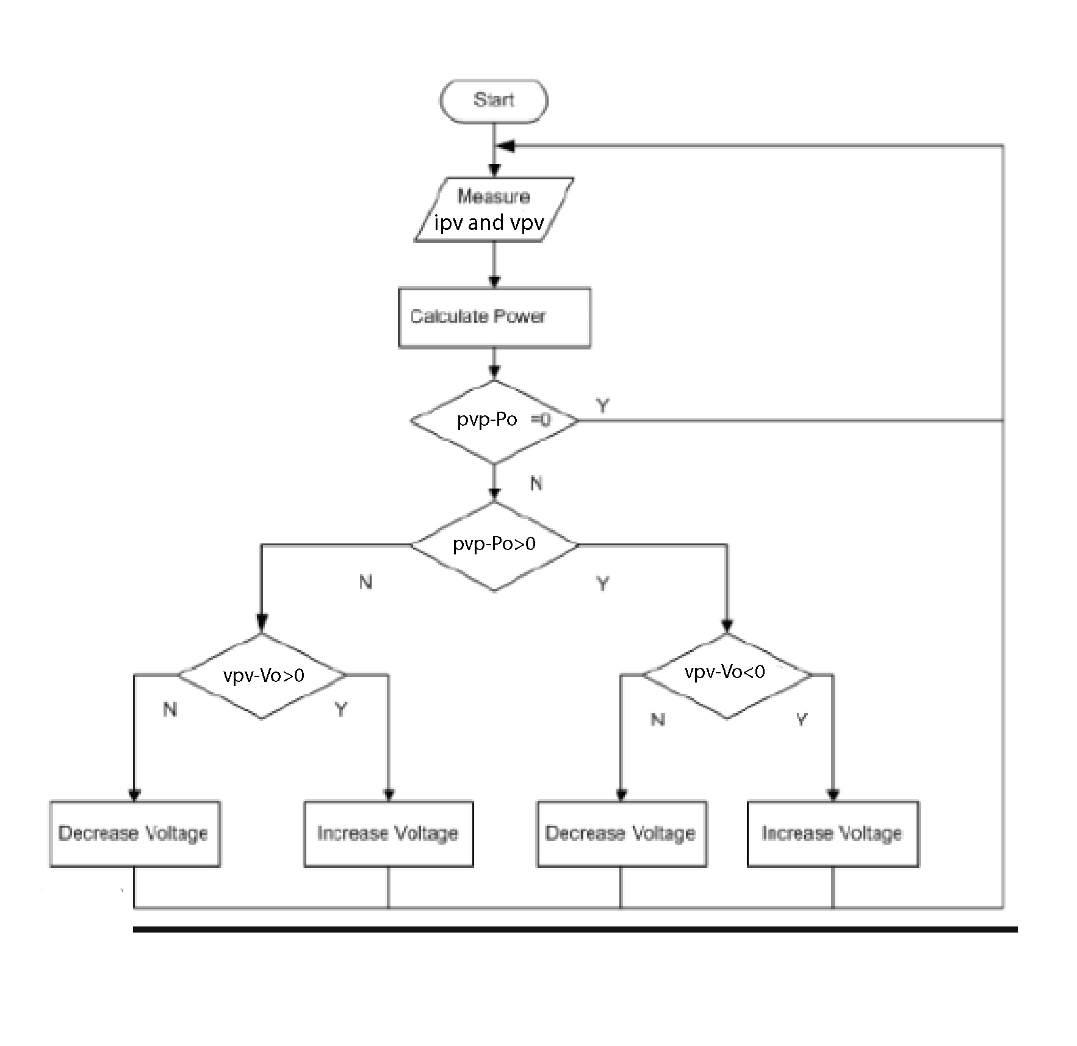
PERTURB AND OBSERVE ALGORITHM FLOW CHART & CODE
Fig 6. Perturb and Observe flowchart [12]
Fig 7. . Perturb and Observe algorithm code
29-May-21
Department of Electrical & Electronics Engineering
9

Slide 10
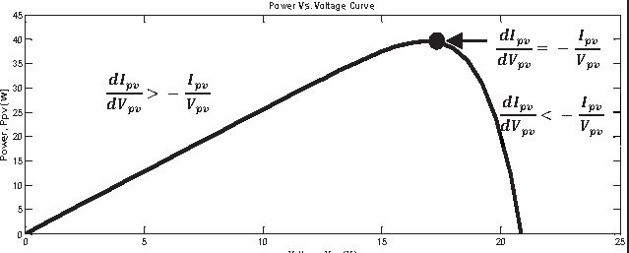
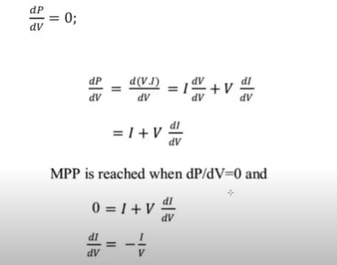
INCREMENTAL CONDUCTACE ALGORITHM
Fig 8. Incremental Conductance graph [14]
Fig 9. Incremental Conductance graph [16]

Slide 11
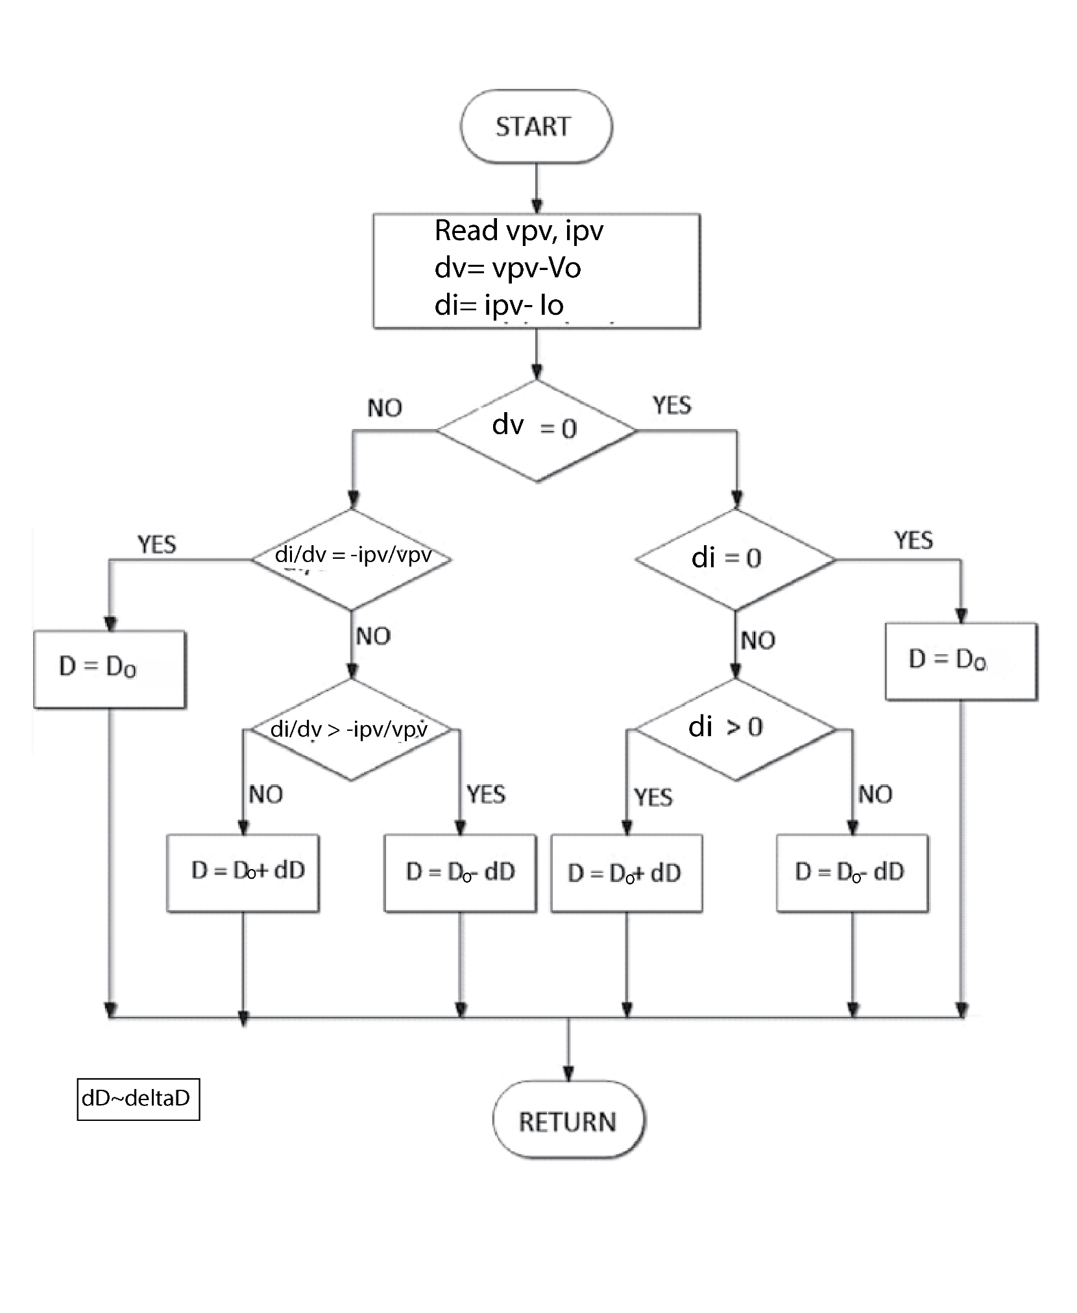
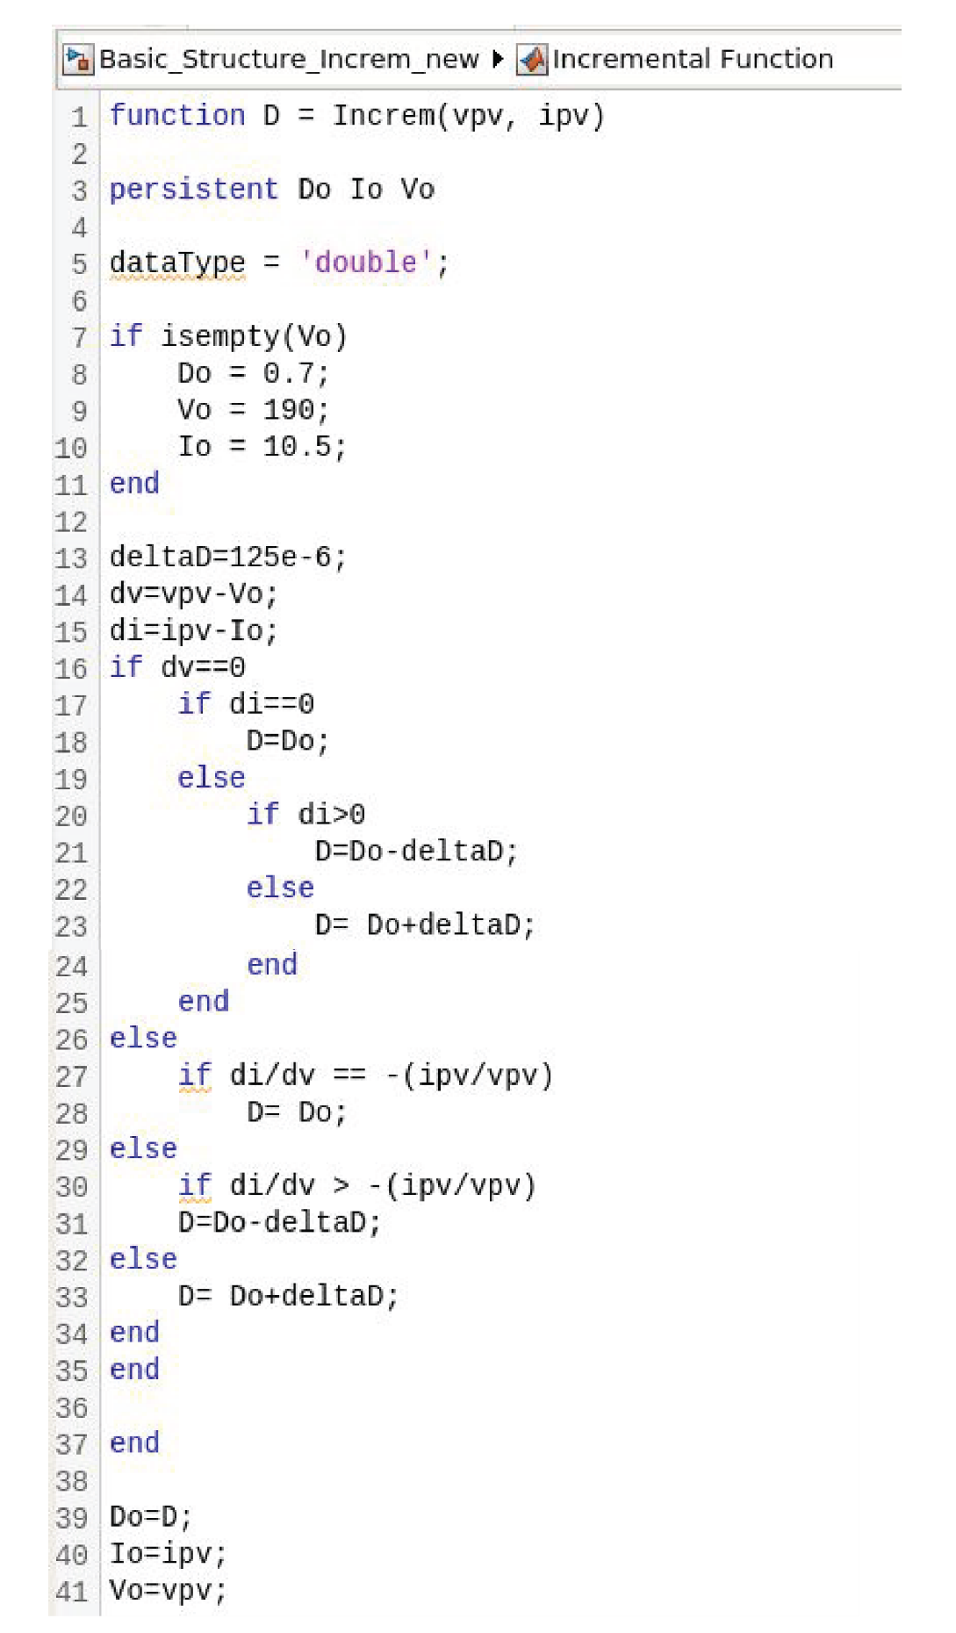
INCREMENTAL CONDUCTANCE ALGORITHM FLOW CHART & CODE
Fig 10. Incremental Conductance flow chart [17]
Fig 11. Incremental Conductance algorithm code

Slide 12
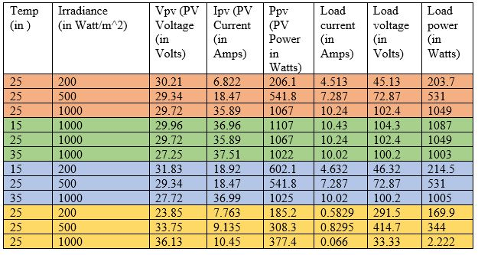
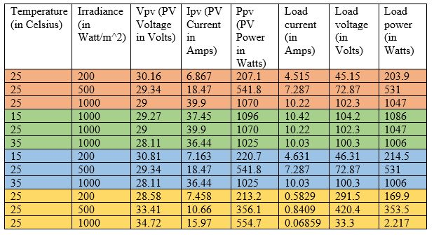
RESULT AND ANALYSIS
Following are the different cases that have been observed during the implementation:
Table 1. Numeric Values of Perturb and Observe algorithm
Table 2. Numeric Values of Incremental Conductance algorithm
Load is 10 ohms for Case 1, 2 and 3. For the 4th case the load is 500 ohms

Slide 13
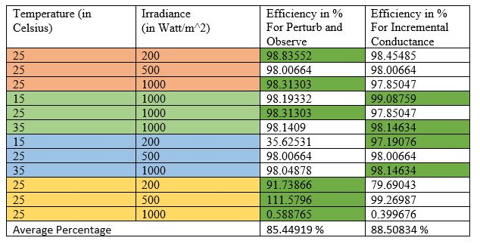
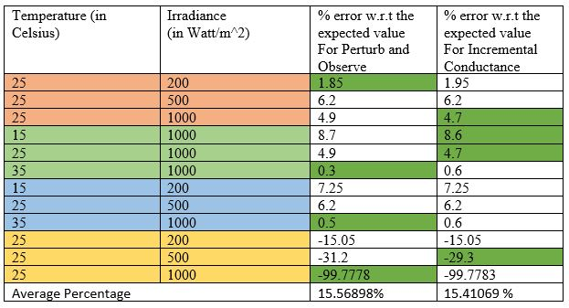
Table 3. Efficiency comparison of both the algorithms (Dark green highlight signifies numerically higher value)
Table 4. % error w.r.t the expected value for both the algorithms (Dark green highlight signifies numerically lower value)

Slide 14
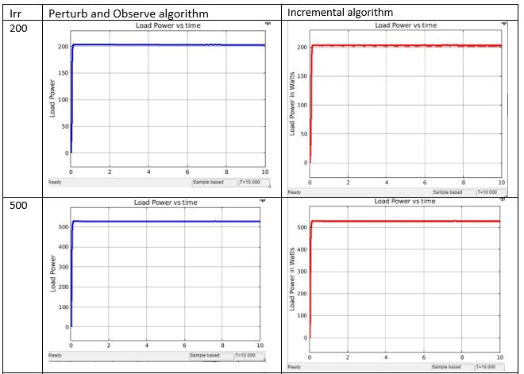
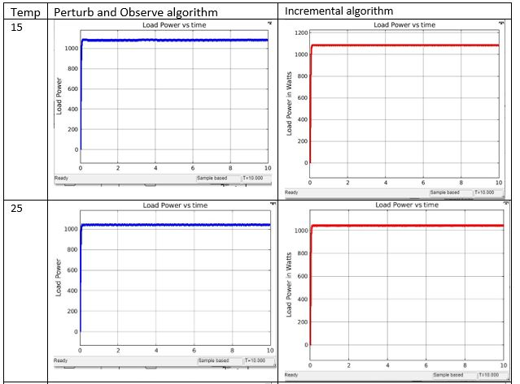
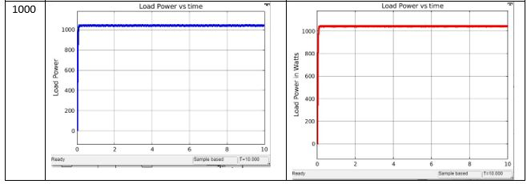
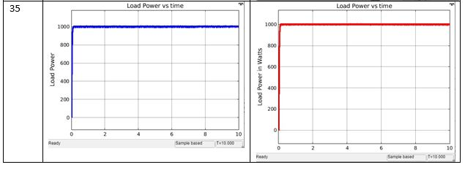
Table 5. Case 1 graphs: Constant temperature (25 degrees Celsius) and Variable Irradiance. (Load=10ohms)
Table 6. Case 2 graphs: Constant Irradiance (1000 Watt/m2) and Variable temperature. (Load=10ohms)

Slide 15
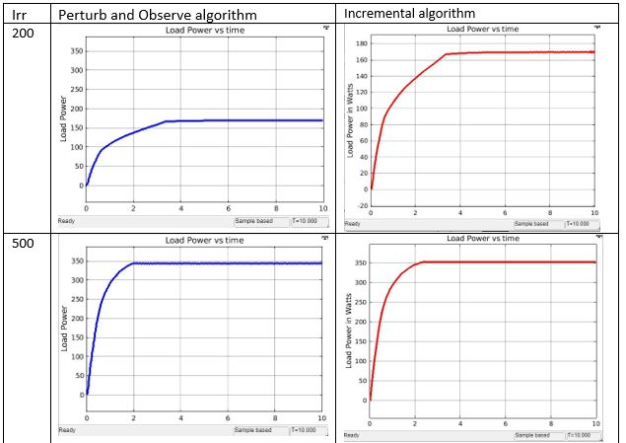
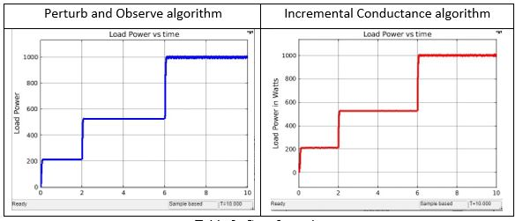
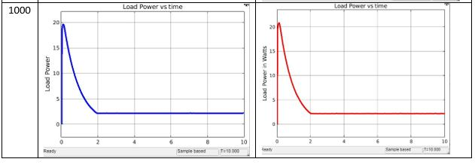
Table 7. Case 3 graphs: Variable temperature and Variable Irradiance. (Load=10ohms)
Table 8. Case 4 graphs: Constant temperature (25 degrees Celsius) and Variable Irradiance. (Load= 500 ohms)

Slide 16
CONCLUSIONS
By analysing and observing all the cases for both Perturb and Observe algorithm and Incremental Conductance algorithm we could observe the variation in the performance of the model.
All in all, in most of the cases we observe that output result satisfy the objective of the MPPT controller. Which is to get the expected output power in respective cases. Other than that by observing and analysing the output results from both the algorithms, it can be satisfactorily concluded that the Incremental Conductance algorithm gives better result in term of efficiency as compared to Perturb and Observe algorithm, which of course indirectly is cost effective.
We need to eventually switch to more environmental friendly sources of energy, and with the improvement in the efficiency in terms of both power and cost via using MPPT controller, we can surely look forward to harnessing solar power in wider amounts and anticipate more realistic projects in the future.

Slide 17
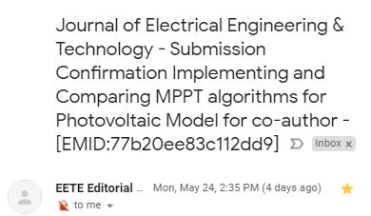
Outcome of the project: Submitted the paper to international journal “Journal of Electrical Engineering and Technology”

Slide 18
IMPACT ON ENVIRONMENT/SOCIETY/COMMERCE OR OTHER FACTORS
Currently in India there is a lack of awareness in this field, although there are many households and many other projects which rely on solar power. It is expected that eventually apps would be available to operate the controllers through smart phones and tablets via the internet for ease of use. Also DC power can be directly taken and MPPT and be directly used for DC devices. Also since the efficiency of solar power plants would increase to such a significant amount it is also possible that their demand might increase. These days they are available with LED display.
There is still lack of awareness and regulation regarding MPPT controllers in India and hence there is slow progress in the practical usage.
Coming to environmental factors, post installation of the solar power plants there is no emission of greenhouse gases. Unlike the conventional sources of energy where we can see that it causes significant amount of water pollution and oil pollution, in the case of solar power plant they do not require water for cooling and hence do not cause water pollution. This method also promises long term durability and prevents us from relying on conventional sources of energy eventually.

Slide 19
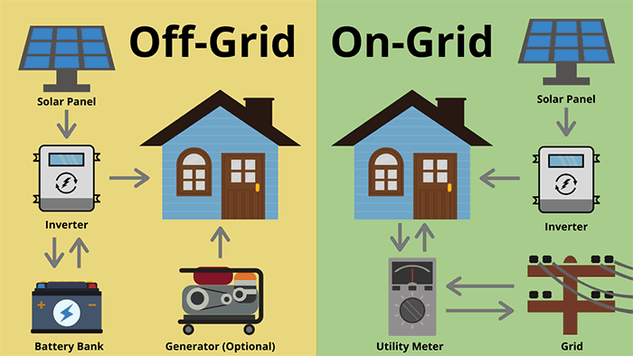

Slide 20
REFERENCES
[1] Alpesh P. Parekh Bhavarty N. Vaidya and Chirag T. Patel, “Modlling and Simulation Based Approach of Photovoltaic System”,in Global Research Analysis Volume 2 Issue 4 April 2013 ISSN NO. 2277 -8160.
[2] N. Pandiarajan and Ranganath Muth, “Mathematical Modelling of Photovoltaic Module with Simulink”,in 2011 1st International Conference on Electrical Energy Systems.
[3] Anuradha and Satish Kumar, “Study and Comparison of various MPPT Algorithms in Solar Power System”, JISET- International Journal of Innovaive Science, Engineering & Technology, Vol. 2 Issue 12, December 2015.
[4]A. Dolara, R. Faranda, S. Leva, ”Energy Comparison of Seven MPPT Techniques for PV Systems”, J. Electromagnetic Analysis & Applications, 2009, 3: 152-162
[5] Muhammad H Rashid, “Power Electronics:Circuits,Devices and Applications”, Pearson, 4th Edition, 978-0133125900
[6] Jitendra Prasad, “Maximum Power Point tracker solar charge controller(MPPT)”, LAP LAMBERT Academic Publishing, 2012, 978-3659185083
[7] Solar Power diagram , www.howstuffworks.com
[8] Solar Cell , www.howstuffworks.com
[9] http://home.iprimus.com.au/nielsens/
[10] Solar PV World Expo https://www.pvresources.com/
[11] MPP Graph https ://electricalacademia.com/renewable-energy/maximum-power-point-tracking-mppt-charge-controller-working-principle/
[12] Flow Chart perturb and Observe https://www.researchgate.net/publication/277339128_Maximum_Power_Point_Tracking_for_Photovoltaic_Using_Incremental_Conductance_Method/figures?lo=1
[13]MPP graph: A. Belhadj Dejilali “Modified perturb and observe MPPT control for avoid deviation in photovoltaic system”, January 2017 Journal of Electrical Engineering 17
[14]MPP graph: Md Wazedur Rahman, S Bathima, R Prasanth “Comparative analysis of developed incremental conductance (IC) and perturb & observe (P&O) MPPT algorithm for photovoltaic applications”, in 2016 10th International Conference on Intelligent Systems and Control (ISCO)
[15] Practical MPPT: https://inverterandbattery.com/product/inverter-battery-solar-charger-controller/
[16] https://www.youtube.com/watch?v=yzPp2cWRz44
[17] https://link.springer.com/article/10.1007/s41870-020-00450-8
29-May-21
Department of Electrical & Electronics Engineering
20

